Slide 1
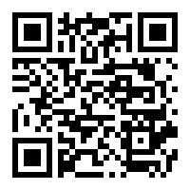
Credit by
Demonstrated Mastery
2017-2018
If you feel you already know the content of a high school course, you have the opportunity to explore Credit by Demonstrated Mastery. You will need to talk to your counselor, complete an application, score a Level V on the EOC or 90% correct on an exam, and complete an artifact. You might be able to show mastery and move into more challenging courses!
For Summer 2017, applications are due June 2, 2017.
For other courses, applications are due December 15, 2017.
For more information
See your school counselor or
check out these websites
http://academicinnovation.weebly.com/cdm.html
http://cdm.ncdpi.wikispaces.net/.

