Slide 1
Science Safety: Protective Equipment

Slide 2
Key Question
What protective equipment should be provided in elementary science environments (indoors or out) for teacher and student use?

Slide 3
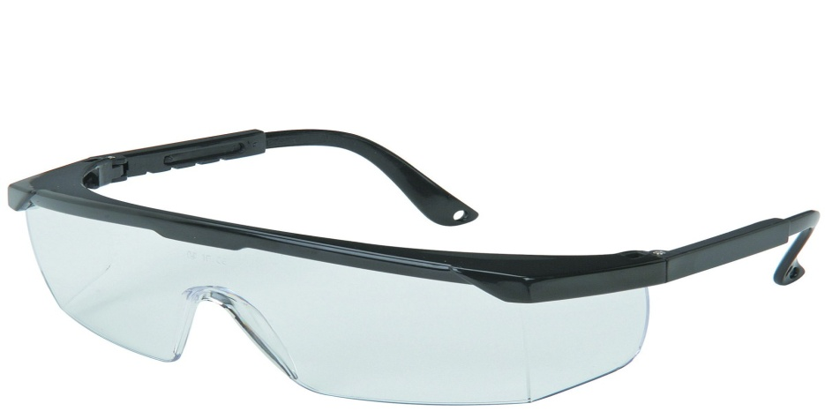
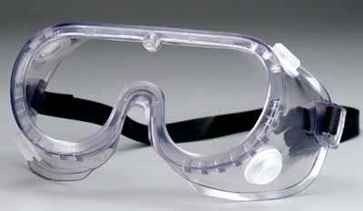
Safety Goggles
Impact Goggles
Chemical Splash Goggles
When are Impact Goggles appropriate?
When are Splash Goggles appropriate?

Slide 4
Sanitizing Materials for Goggles
Alcohol Wipes: kill bacteria and some lice only on the sides and bands
Wipe all surfaces with soap and water on surfaces
Allow to dry

Slide 5
Aprons
Non- absorbant
Chemical Resistant
For each student
When there is a possibility of spillage or spattering of chemicals or hot water
When are aprons needed and appropriate?

Slide 6
Safety Gloves
When handling animals, plants, soil samples
When handling things that might contain harmful micro-organisms or allergens
Be aware of latex allergies
When are saftey gloves needed and appropriate?

Slide 7
Eyewash Stations
Faucet Type
If concerns of chemical or particle in eyes
Low enough for students to access

Slide 8
Fire Extinguishers
Adequate number
Adequate type
A (paper, wood, cloth, rubber, grease)
B (burning liquids, gases or greases)
C (burning electrical equipment)
PASS (Pull, Aim, Squeeze, Sweep)

Slide 9
GFI Outlets
Should be all outlets in an elementary classroom
Outlet cover should guard against objects being poked into
Should be capped when not in use

Slide 10
First Aid Kits
Check with school policy
Be aware of student allergies
School Nurse as a resource

Slide 11
Safety Posters
Prominently Displayed
Referenced
Student Interpretations
Emergency procedures and numbers should be posted

Slide 12
Disposal
Chemical Waste
Bacterial Growth Plates (not in elementary rooms)
Dead Animals
Animal Waste
Dead Plants
Spilled Liquids
Releasing Pets

Slide 13
Sign School Safety Roster
Be sure to understand each of the previous items
Sign the Roster attesting your understanding

Slide 14
Reflection Questions
How do the topics in this presentation impact your classroom?
What is one best practice that relates to this topic that you would share with colleagues or our staff?

