Slide 1
Let’s Go Fly A Kite!

Slide 2
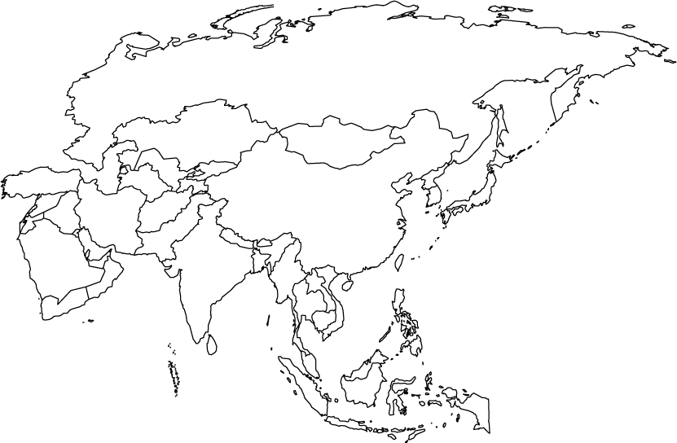
Continent of Asia

Slide 3
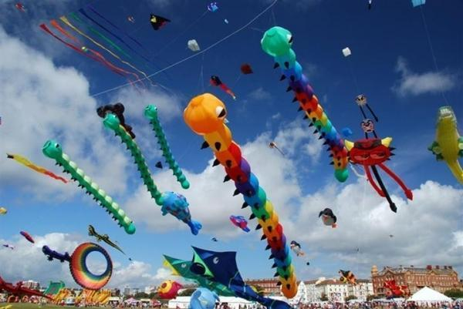
International Kite Festival in India
Held every year on January 14th to celebrate the end of winter!
video

Slide 4
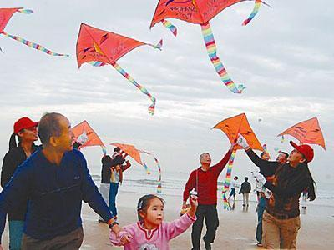
Weifang International Kite Festival in China
This festival is held every year between April 20 – 25th. Most people consider Weifang the birthplace of kites.

Slide 5
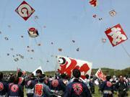
Hamamatsu Kite Festival in Japan
This kite festival occurs May 3rd – 5th. On May 5th, kites are flown to celebrate boys being born to the family.

Slide 6
Clyde Erwin IB Kite Festival!
Your team has been asked to create the very first kites for the Clyde Erwin IB Kite Festival –celebrating all things IB. Your kite will be made from at least 3 different shapes. Each shape will represent a part of IB – an attitude; a learner profile; and a student action you have participated in during this school year. You will create your prototype on PPT and then use that to create a real kite. You will have choices of materials to choose from but will have to purchase them and stay on budget. When the kite is done, we will use our weather skills to test wind speed and our estimation skills to see how high the kite flies!

Slide 7
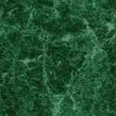
Clydette
Notes:
The mouth is a half circle and shows the learner profile of communicator. The bow is two triangles and a square and represents the IB attitude of cooperation. The student action is represented by a half circle and rectangles showing that I helped with collecting donations for United Way which helps a lot of charities.

Slide 8
Attributes Questions to Answer
Is it 2D or 3D?
How many sides does it have? (2D)
How many edges does it have? (3D)
How many angles does it have?
How many vertices does it have?
Is it an open shape or a closed shape?

