Slide 1
STEAM Education
Why is STEM education Important?

Slide 2
Review: What is STEM?

Slide 3
STEM Education
Science
Integrates the study of Science, Technology, Engineering & Mathematics
Uses Scientific Inquiry & Engineering Design as unifying templates or themes
Engineering
Math
Technology
Notes:
Integration is key

Slide 4
STEM Education
Emphasizes 21st-Century Skills
--Critical thinking & problem solving
--Communication
--Collaboration
--Creativity & innovation
Rigorous & relevant learning

Slide 5
What is STEM?
STEM
Not STEM
Student-centered
Inquiry-based
Integrates Science, Technology, Engineering, and Math
Emphasizes innovation, problem-solving, critical thinking, and collaboration
Rigorous, relevant, and authentic learning
Teacher-centered
Robotics only
Subjects taught in isolation
Highly specialized for an elite group of students
Only for those interested in Science, Engineering, Technology, or Math

Slide 6
Why is STEM Education Important?

Slide 7
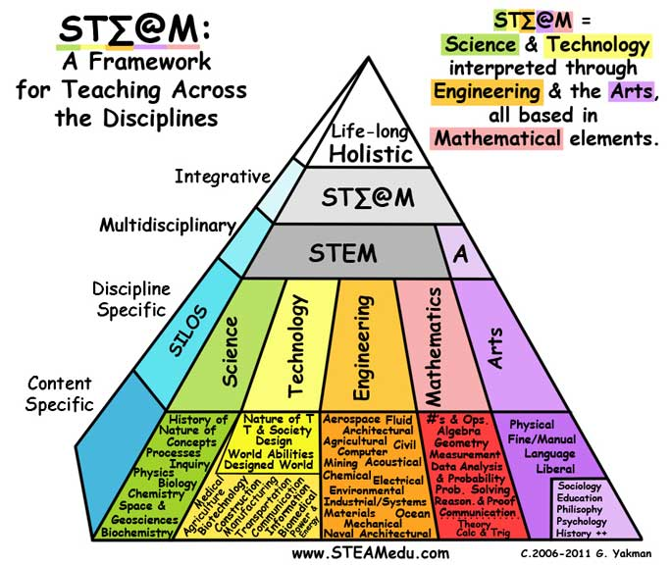
http://www.topeducationdegrees.org/stem/

Slide 8
How do I create STEM lessons?

Slide 9
Examples
What does a STEM lesson look like?

Slide 10
STEM Lessons: Characteristics
Rigorous
Standards-based
Integrated: STEM (especially T and E)
Project-based
Collaborative
Problem-Solving
Authentic and “Real World”

Slide 11
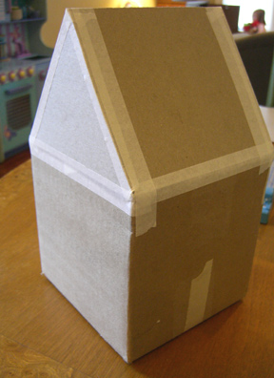
Heat Transfer
Science | Technology | Engineering | Math
Heat Transfer | Thermometer, Radiometer, Computers | Design process | Ratios, Rates, and Proportions

Slide 12
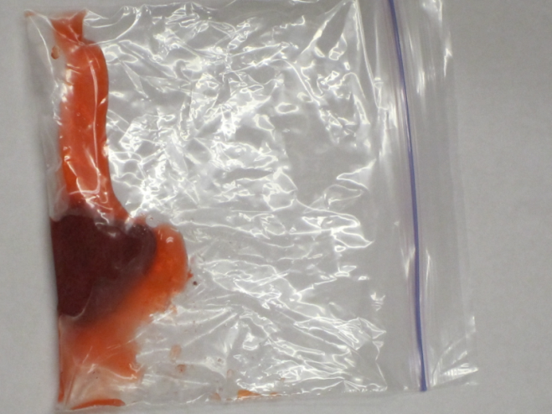
STEM-ifying a lesson: Strawberry DNA extraction
Engineering
developing a kit to extract most DNA at least cost (process engineering)
Math
cost of extraction/unit of DNA
mass of DNA extracted/mass of original sample
business: sell DNA necklaces

Slide 13
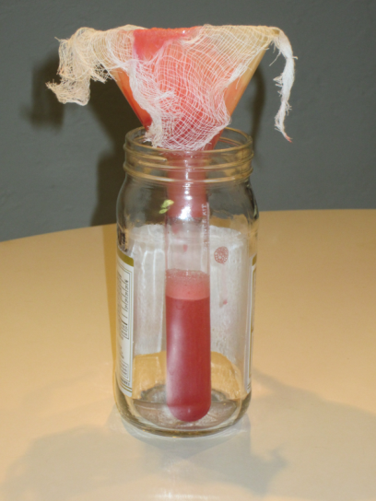
STEM-ifying a lesson: Strawberry DNA extraction
Science: Inquiry
types of strawberry (frozen vs. fresh)
types of sample (banana, strawberry, cheek cells)
type of alcohol (isopropyl vs. ethanol)
concentration of alcohol (70% vs. 91%)
temperature of alcohol (room temp vs. ice-cold)
type of strainer (filter paper vs. cheesecloth)
type of detergent (Dawn vs. Palmolive)

Slide 14
STEM-ifying a lesson: Strawberry DNA extraction
Technology
interactive whiteboard
video clips/simulations
talk about the technology of DNA extraction ($1000 for your DNA, newspaper articles)
Documentation/users manual (video/photos/sharing)
graphing

Slide 15
Parachute Drop
Grades K-1
http://www.youtube.com/watch?v=p2cmOJEFaZM (instructional video 8minutes for teacher)
Purpose: To explore how different materials react to different forces.
Guiding Questions:
What is a force?
What types of forces are there?
Need guiding questions to lead into the math component and data collection-- ???
Materials:
Coffee filters
Thin plastic bag
Wax paper
Thin cloth
Cheesecloth or gauze
3 to 15 strings for each parachute
1 heavy paper clip or three identical small weights
What to Do:
Cut out three parachute circles, all the same diameter
Attach 3-15 strings to each parachute. Use the same number of strings.
Drop each chute from the same height. (The higher you start the drop, the better your results.) Count how long each parachute takes to reach the ground.
Collect the data on a board, chart paper or on the computer.
Which material made the slowest drop? Why?
Which material made the fastest drop? Why?

Slide 16
Digestive System lesson
Physical Science Introduction

Slide 17
Questions?

