Slide 1
Using Art in a Science & Math Classroom
Jennifer Rogers
6th Grade Math/Science Teacher
Hunters Creek Middle School

Slide 2
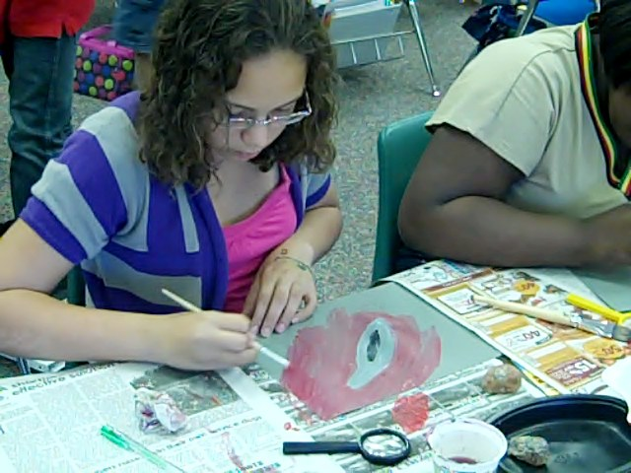
Goals for this Session
Demonstrate integrated lessons
Communicate methods for using art to assess science concepts
Share first-hand experiences of using art in the science classroom

Slide 3
Integrating Art in the Science Classroom
In my classroom, art integration includes using a work of art, like a painting or sculpture, to discuss and explore science concepts.
Students then use that work of art as inspiration to create their own artwork, which also ties to the science concept we are studying.
Notes:
I have used both of these methods to assess what my students know and/or what they have learned about the science topic that we are studying. Although this is much different than a paper/pencil test, it engages students while still requiring them to apply what they know to be successful.

Slide 4
The Power of Observations
Rock Painting Lesson - a 6th grade Science plan that incorporates relating the texture of different types of rocks to the texture in art.

Slide 5
Relating Rocks to a Work of Art
Microscopic view of mineral formations in rocks
Franz Kline’s
Orange Outline
Notes:
When trying to find a work of art that related to rocks, I found this image of a crystal formation in a rock, which reminded me a lot of Orange Outline. By researching Franz Kline, I learned that Kline liked to take a small picture and paint it to a larger scale. To do this, careful observations are needed, which is also something that I teach in my science class. This painting was not only resembled the crystals in a rock, but also had a lot of texture, which is a word that could be related to both Art and Geology, so it seemed to fit in perfectly with what we were studying. These discoveries allowed me to take this painting and use it to enrich our study of the types of rocks.

Slide 6
Essential Standards Connections
Science 6.E.2.3 - Explain how the formation of soil is related to the parent rock type and the environment in which it develops.
Visual Arts 6.V.1.1 - Use appropriate vocabulary to describe art, including Elements of Art, Principles of Design, types of media, various processes, and style.
6.V.2.2 - Use observation skills of the immediate environment to create original imagery.
6.V.3.3 - Create art in different media using various techniques and processes.
Student Product

Slide 7
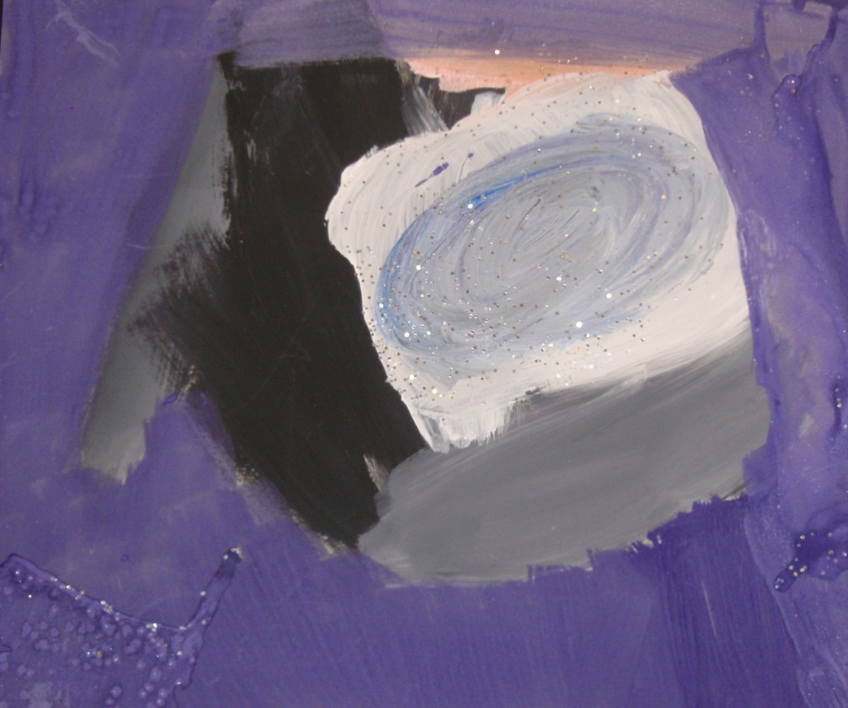
1st Grade Application
Science 1.E.2.1 - Summarize the physical properties of Earth materials, including rocks, minerals, soils and water that make them useful in different ways
Visual Arts 1.V.1.2 - Create original art that expresses ideas, themes, and events.
1.V.1.4 - Understand characteristics of the Elements of Art, including lines, shapes, colors, textures, form, and space
1.CX.2.2 - Identify connections between art and concepts from other disciplines, such as math, science, language arts, social studies, and other arts.
Student Product

Slide 8
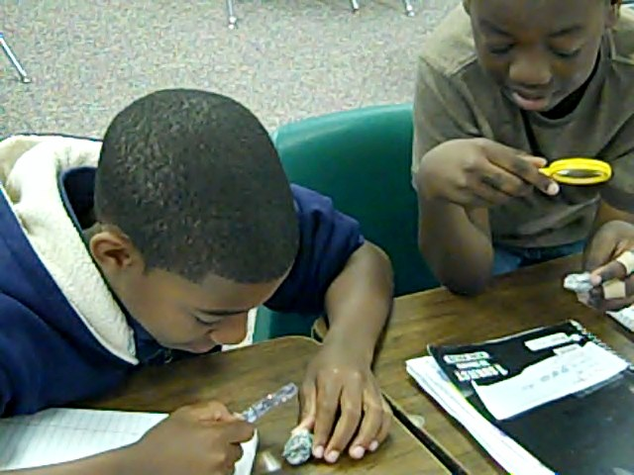
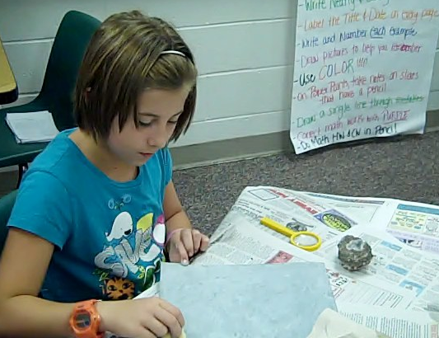
Learning Objectives for both Art and Science
Students will apply knowledge of rock characteristics to classify rocks as either igneous, sedimentary, or metamorphic.
Students will explore textures of various objects, including rocks and artwork, and use words to describe texture (including geology terms).
Students will identify texture and scale in art.
Students will incorporate texture and scale into an observational painting of a rock sample.

Slide 9
The Power of Observation
After studying the characteristics of three types of rocks, students are encouraged to use careful observations to classify different rocks as igneous sedimentary or metamorphic.
Students then take what they know about Geology and compare it to techniques used in art.

Slide 10
Orange Outline Franz Kline
Notes:
The lesson begins by students observing the painting Orange Outline. As a class, we discuss this painting, including observations we can make, conclusions that we can draw from the observations, the subject of the painting, etc. Students are encouraged to share their thoughts, ideas, and conclusions. Using this painting, the art topics of texture and scale are introduced. The concept of texture is discussed as it relates to both Geology and art.

Slide 11
After discussing Orange Outline…
Students use Orange Outline as a guide to create their own scale painting, using a rock as the subject.
Students pick out a small portion of their rock to paint, adding layers of paint and other materials to add texture to their paintings.
Notes:
Before beginning this activity, the students decide what tools they could use to add texture to their paintings. After hearing their thoughts, I provide them with sponges, sand, glitter, and gesso. They are encouraged to pick out their own rock subject and imitate Kline’s process of creating a scaled, texturized painting.

Slide 12
Assessment – How do I know the students met the Learning Goals?
After students complete their paintings, they compare their paintings to their rock and analyze the process through writing a guided reflection. Questions include:
Describe the texture of your rock
What type of rock do you think your sample is? What observations lead you to believe that?
What tools did you use to create texture in your painting? Explain the process you went through.
How is your painting similar/different to your rock
How are observations used in art and science? Why are they important?
Notes:
One way that I assess students on this project is by having them complete a guided reflection. Through the reflection, the students are able to tell me what observations they made about their rock, how their observations led them to conclude what type of rock it is, and the process that they went through to create their painting. I also ask them to reflect on why careful observations are important in both science and art.

Slide 13
Assessment Tool - Shared Rubric
Painting Skill
Creativity
Planning and Explanation
Capturing a Style/Artist
Knowledge of Geology
Notes:
I also use a shared rubric to assess the students’ knowledge of the Geology and Art objectives. This was developed to show students how they can be successful and what is expected of them. I usually share them before the entire painting process begins.

Slide 14
Sample Paintings

Slide 15
Sample Paintings

Slide 16
Weather Forecasting and Cloud Paintings
A 7th grade Science lesson plan where students explore clouds, the weather associated with clouds, and how weather is depicted in paintings.

Slide 17
Essential Standards Connections
Science 7.E.1.4 - Predict weather conditions and patterns based on information obtained from: Weather data collected from direct observations and measurement (wind speed and direction, air temperature, humidity and air pressure); Weather maps, satellites and radar; Cloud shapes and types and associated elevation.
Visual Arts 7.V.2.2 - Use observation skills of the environment and personal experiences to create original imagery. 7.V.3.3 - Compare techniques and processes to create art. 7.CX.1.1 - Understand the visual arts in relationship to the geography, history, and culture of modern societies from the emergence of the First Global Age (1450) to the present.
Student Product

Slide 18
2nd and 5th Grade Application
Science 2.E.1.2 - Summarize weather conditions using qualitative and quantitative measures to describe: Temperature, Wind direction, Wind speed, Precipitation
2.E.1.3 - Compare weather patterns that occur over time and relate observable patterns to time of day and time of year.
2.E.1.4 - Recognize the tools that scientists use for observing, recording, and predicting weather changes from day to day and during the seasons.
Visual Arts 2.V.2.3 - Create art from real and imaginary sources of inspiration. 2.CR.1.1 - Use art terminology to describe art in terms of subject and physical characteristics.
Science 5.E.1.1 - Compare daily and seasonal changes in weather conditions (including wind speed and direction, precipitation, and temperature) and patterns.
5.E.1.2 - Predict upcoming weather events from weather data collected through observation and measurements
Visual Arts 5.V.2.2 - Use ideas and imagery from the global environment as sources for creating art.
5.V.2.3 - Create realistic, imaginative, abstract, and non-objective art.
5.CX.2.2 - Exemplify how information and skills learned in art can be applied in other disciplines.

Slide 19
Learning Objectives
Students will apply knowledge of various types of clouds and their relationship to weather systems.
Students will explore en plein air paintings and analyze the impact of technology on artists' working materials and processes.
Students will create a weather report based on observations and evidence from a painting.
Students will incorporate their knowledge of clouds and weather systems to create a cloud painting.
Students will reflect on the process through a reflection paragraph.

Slide 20
Relating Weather to a Work of Art
After studying clouds and the weather related to the different types, students will be introduced to Eugène Boudin’s Trouville, The Jetties, High Tide
Students will discuss what they observe in the painting and use these clues to guess what they think the weather would be like.
Eugène Boudin Trouville, The Jetties, High Tide, 1876
Notes:
For this lesson, the students are required to use their knowledge of clouds and the weather related to clouds to create a weather report. By using the clues and observations from the painting, the class creates a weather report (including temperature, precipitation, fronts, how to dress, etc)

Slide 21
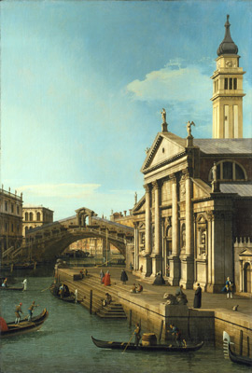
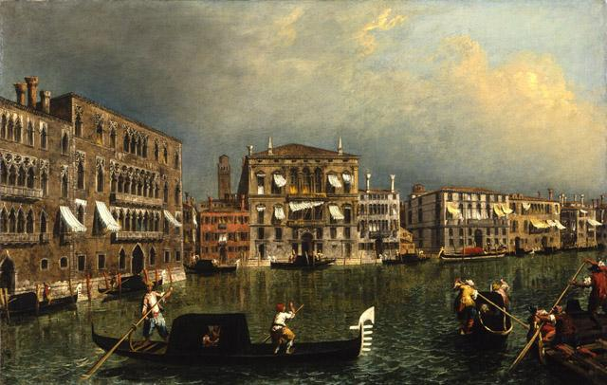
After using the class forecast as an example, the students work together in a group to create their own weather report for a French or Italian painting to present to the class.
Giovanni Antonio Canal Capriccio: The Rialto Bridge and The Church of S. Giorgio Maggiore, 1750
Michele Marieschi The Grand Canal at the [Rio di] Ca’ Foscari, 1740-1743
Notes:
Each group is assigned either a French or Italian painting. As a group (and by using a guided handout), students work together to make their own observations and conclusions about the painting. The students then use the observations to create a weather report about the painting. For this to be successful, students must be knowledgeable of the types of clouds and the weather associated with the clouds. Students are encouraged to research weather history for the specific areas to assist them in creating their report.

Slide 22
After the weather forecasts…
Students are encouraged to use the French and Italian paintings as inspiration to create their own cloud paintings. Their paintings should show a specific type of cloud and evidence of weather conditions.
Claude Monet The Cliff, Etretat, Sunset, 1883
Notes:
Besides painting a specific type of cloud, students are also encouraged to add evidence in their painting that shows a specific type of weather.

Slide 23
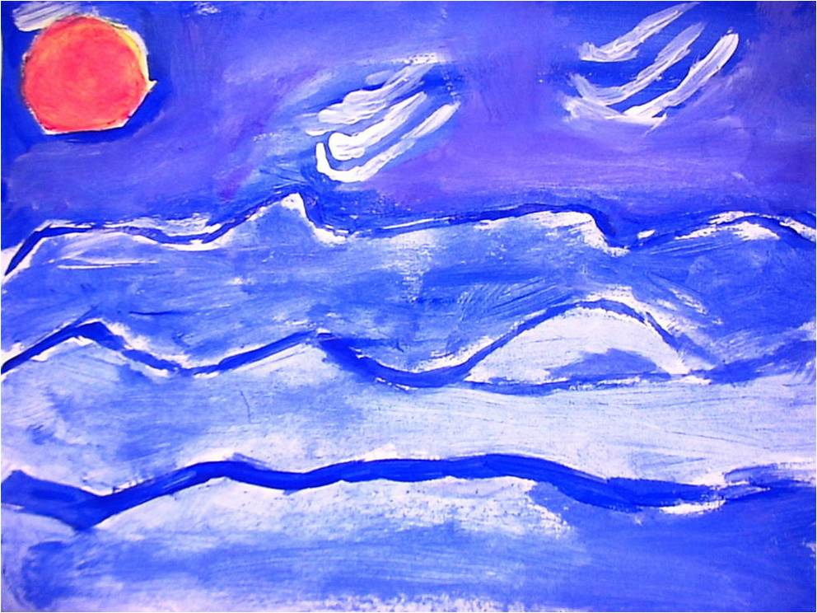
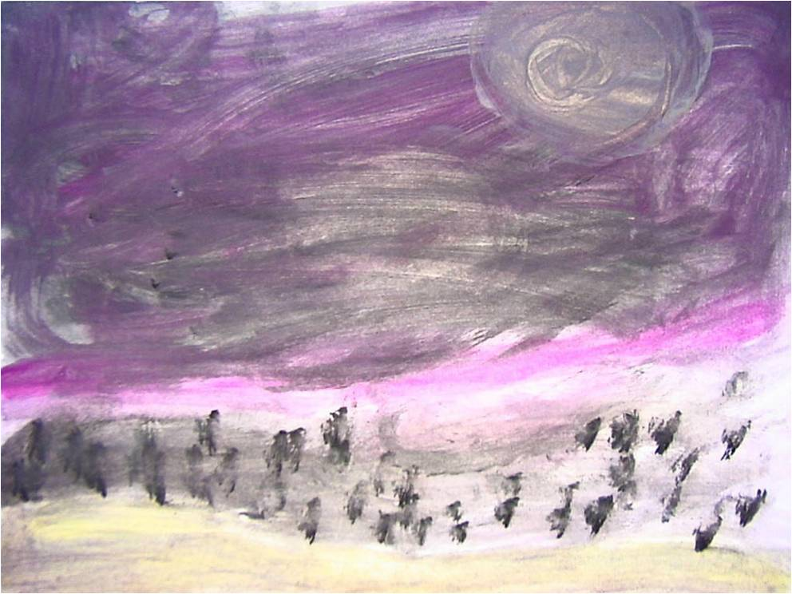
Assessment Strategies
Informal Assessment
Group Handout
Rubric for weather report
Painting reflection
Notes:
For this project to be successful, students must know the types of clouds and the weather associated with those types of clouds. Through class and group discussions, students are required to use their knowledge of weather to participate, which can be assessed informally. Students are required to complete the group handout, where they would analyze the types of clouds and what type of weather would go with them. The students also would write a guided reflection about their painting, telling the process that they went through to create it, as well as how they painted evidence of a specific type of weather.

Slide 24
Modeling Volcanoes
A 6th grade Science lesson where students discuss misconceptions about volcanoes, explore the types of volcanoes and eruptions, decide how volcanoes impact the environment, and sculpt their own volcanoes.

Slide 25
Essential Standards Connections
Science 6.E.2.2 - Explain how crustal plates and ocean basins are formed, move and interact using earthquakes, heat flow and volcanoes to reflect forces within the earth.
Visual Arts 6.V.1.1 - Use art vocabulary to describe art, including Elements of Art, Principles of Design, types of media, various processes, and style.
6.V.3.3 - Create art in different media using various techniques and processes.
6.CX.2.2 - Understand the connections between art and other disciplines.
6.CR.1.2 - Use formative, self-evaluation strategies and results to improve the quality of art.
.
Student Product

Slide 26
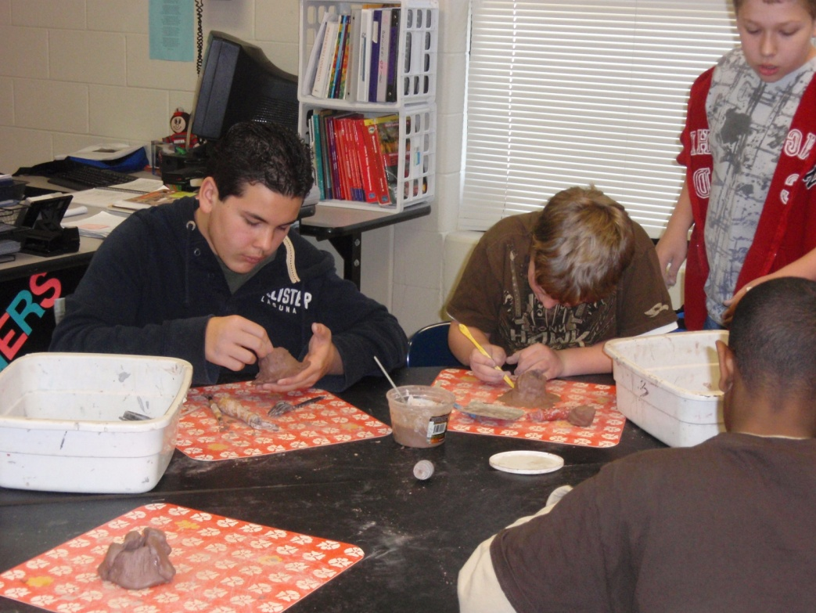
3rd Grade Application
Science 3.E.2.2 - Compare Earth’s land features (including volcanoes, mountains, valleys, canyons, caverns, and islands) by using models, pictures, diagrams, and maps.
Visual Arts 3.V.3.1 - Understand how a single tool can be manipulated in multiple ways, safely and appropriately.
3.V.3.3 - Create art using the processes of drawing, painting, weaving, printing, stitchery, collage, mixed media, sculpture, ceramics, and current technology.
3.CX.2.2 - Understand how to use information learned in other disciplines, such as math, science, language arts, social studies, and other arts in visual arts.

Slide 27
Learning Objectives
Students will compare and contrast types of volcanoes and the different forces within the earth.
Students will explore human responses to natural forces while viewing the work of art.
Students will incorporate their knowledge of volcanoes to create a sculpture while using proper vocabulary and sculpting techniques.
Students will informally assess their product through a reflection and formally assess their work through the use of a rubric.

Slide 28
Students first learn about the three types of volcanoes and how they are similar and different. They are then introduced to Volaire’s painting.
Pierre-Jacques Volaire The Eruption of Mt. Vesuvius, 1777
Notes:
Using Visual Thinking Strategies, the class discusses the painting including: what they might see, smell, and hear if they could step in the painting, how they would feel if they were there, how the volcano impacts the environment, what is the mood of the painting, and what kind of volcano they think Mt. Vesuvius is.

Slide 29
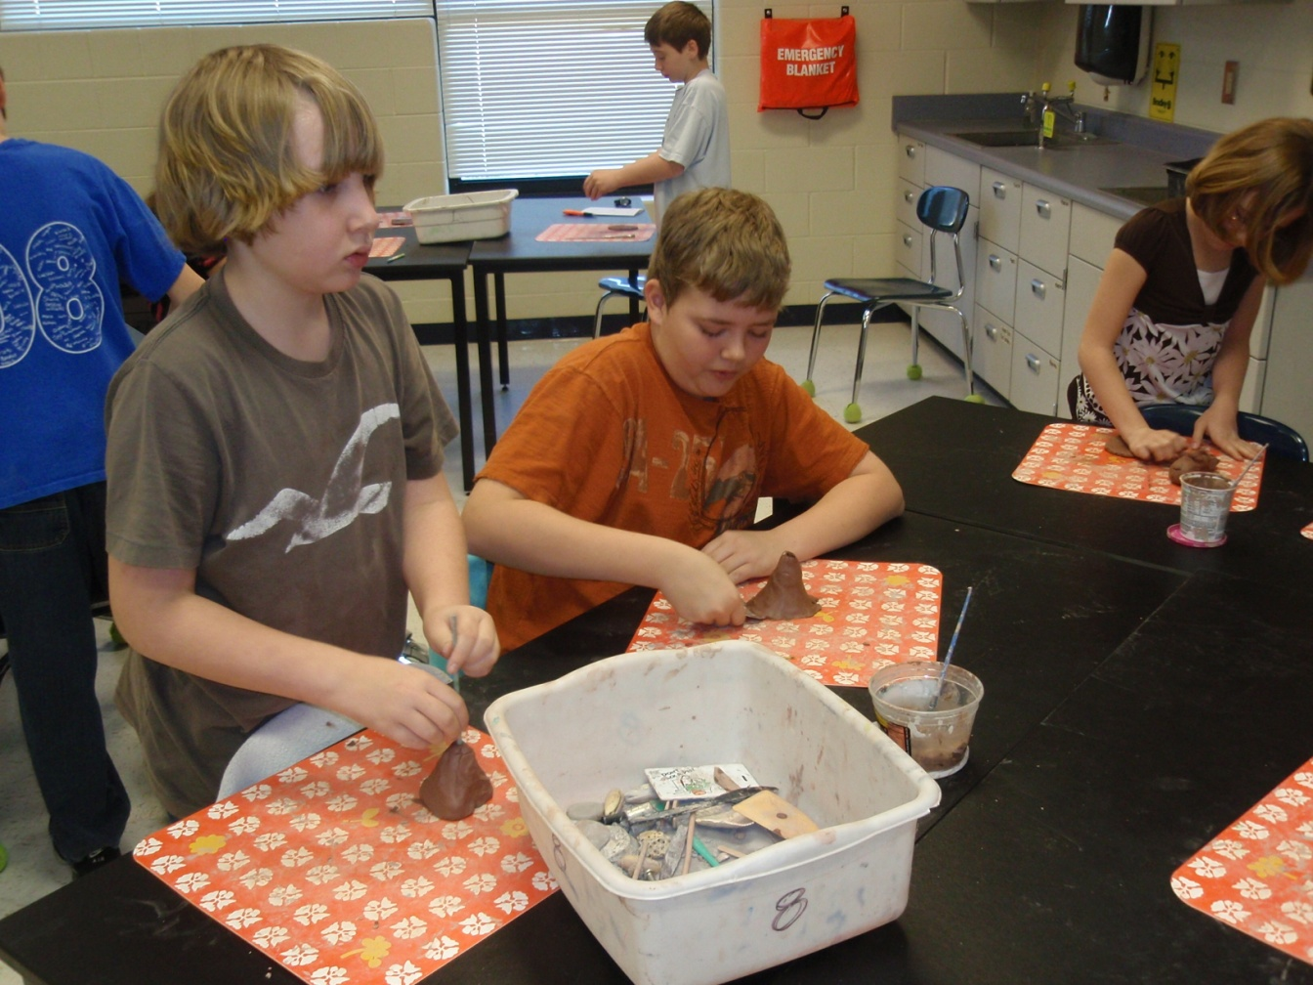
Students then use clay and proper sculpting techniques to create their own volcano
Student Products

Slide 30
Assessment
Reflection
Shared Rubric
What type of volcano did you create?
How does your model show that it represents that type of volcano?
What tools and process did you go through to help create your volcano?
How did you add eruptions or texture to your volcano?
What did you find difficult about working with clay?
How did you use color to help enhance your volcano?
Time and Effort (Visual Arts 6.V.3.3)
Attractiveness/Craftsmanship (Visual Arts 6.V.3.3)
Knowledge about Volcanoes (Science 6.E.2.2)
Knowledge of Volcano Construction (Visual Arts 6.V.3.3)
Analysis of Mt. Vesuvius Painting (Visual Arts 6.V.1.1, 6.CX.2.2, Science 6.E.2.2)

Slide 31
Constructing Circles
A Math lesson plan where students use their knowledge of Geometry to plan and create artwork that shows their understanding of the compass and the measurement of circles.

Slide 32
Essential Standards Connections
Math 7.G.2 - Draw (freehand, with ruler and protractor, and with technology) geometric shapes with given conditions. Focus on constructing triangles from three measures of angles or sides, noticing when the conditions determine a unique triangle, more than one triangle, or no triangle.
7.G.4 - Know the formulas for the area and circumference of a circle and use them to solve problems; give an informal derivation of the relationship between the circumference and area of a circle.
Visual Arts
7.CX.2.2 - Select skills and information needed from other disciplines to solve artistic problems.
Student Product

Slide 33
Learning Objectives
Students will demonstrate their knowledge of parts of circles and their relationships.
Students will use appropriate tools to construct circles of given dimension.
Students will find the circumference and area of the circles they construct.
Students will plan and create original works of art using the concentric circles.

Slide 34
After studying circles, students observe Frank Stella’s Raqqa II and discuss color, patterns, design, and how he may have created this large work of art.

Slide 35
Using Circles to Create Art
Use compass to create concentric circles
Use crayon resistant process to color some circles with crayons and use watercolors for the rest
Cut circles in two or four equal pieces
Arrange the pieces into a new design
Student Product

Slide 36
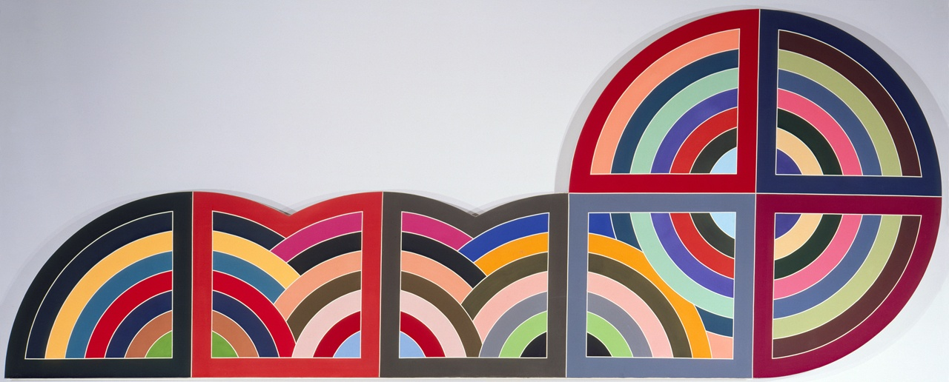
Assessment Strategies Student Handout and Rubric
Math
Art
Students define and find the radius, diameter, circumference, and area of the concentric circles
Students ability to use appropriate tools to create, plan, and organize a work of art
Raqqa II
Franz Kline

Slide 37
Student Responses
“I liked this because we got to closely observe the rock and then tried to make our painting look like it. I learned that the closer you examine something, the more things you can observe.”
~Alyson, 6th grader
“I liked doing art in science. I never knew the two went together.”
~Grace, 6th grader

Slide 38
Personal Learning Experiences
New appreciation for art
Collaboration opportunities
Explore connections between science and art
Create engaging and exciting lesson plans
Notes:
As a person without any background in art, I have learned to question, analyze, and appreciate art, which allows me to pass these skills on to my students. I am encouraged to collaborate and plan with the art teacher, as well as other core teachers at my school. I have explored connections between art and science, which allows me to come up with more engaging lessons for my students and introduces them to things that they may never experience otherwise.

